Slide 1

Quantum Gambling Simulator
- Quantum Monty Hall Problem
- Quantum Prisoner’s Dilemma
Team Bird Vodka
We are undergrads from California universities!
Team Members:
Bryan Yuan (UCSD)
Chris Chen (UCI)
Elvin Lin (UCI)
Haotian Wang (UCI)
Ke Xu (UCI)
We would only illustrate the Monty Hall problem in this presentation!

Slide 2
Classical Monty Hall Problem
Rules:
Alice prepares three identical doors and randomly puts a ball behind one of the doors.
Bob chooses a door.
Alice opens one of the other two doors, showing no ball behind that door.
Bob decides whether to switch his choice to the remaining door.
Alice opens the door Bob chose. Bob wins if he chose the door with the ball behind; Alice wins if Bob didn’t.
Two properties of the game:
Bob has 2/3 winrate if he always switches. This result was counter-intuitive!
This game is biased to Bob, because there is no strategy space for Alice to choose on (The initial ball position does not affect Bob’s winrate due to symmetry of the game).

Slide 3
Quantum Monty Hall Problem
Our inspiration is from these two papers:
Quantum strategies of quantum measurements
Quantum version of the Monty Hall problem
We invented our own rules to the game!
We are aiming for three goals when designing the rules of the Quantum Monty Hall Problem:
It converges to classical case when we limit the choice space from linear combinations of bases to bases only.
It reduces or even eliminates the unfairness of the classical game
There should not be a pure Nash Equilibrium for the game. This ensures that two players won’t have a deterministic strategy.

Slide 4
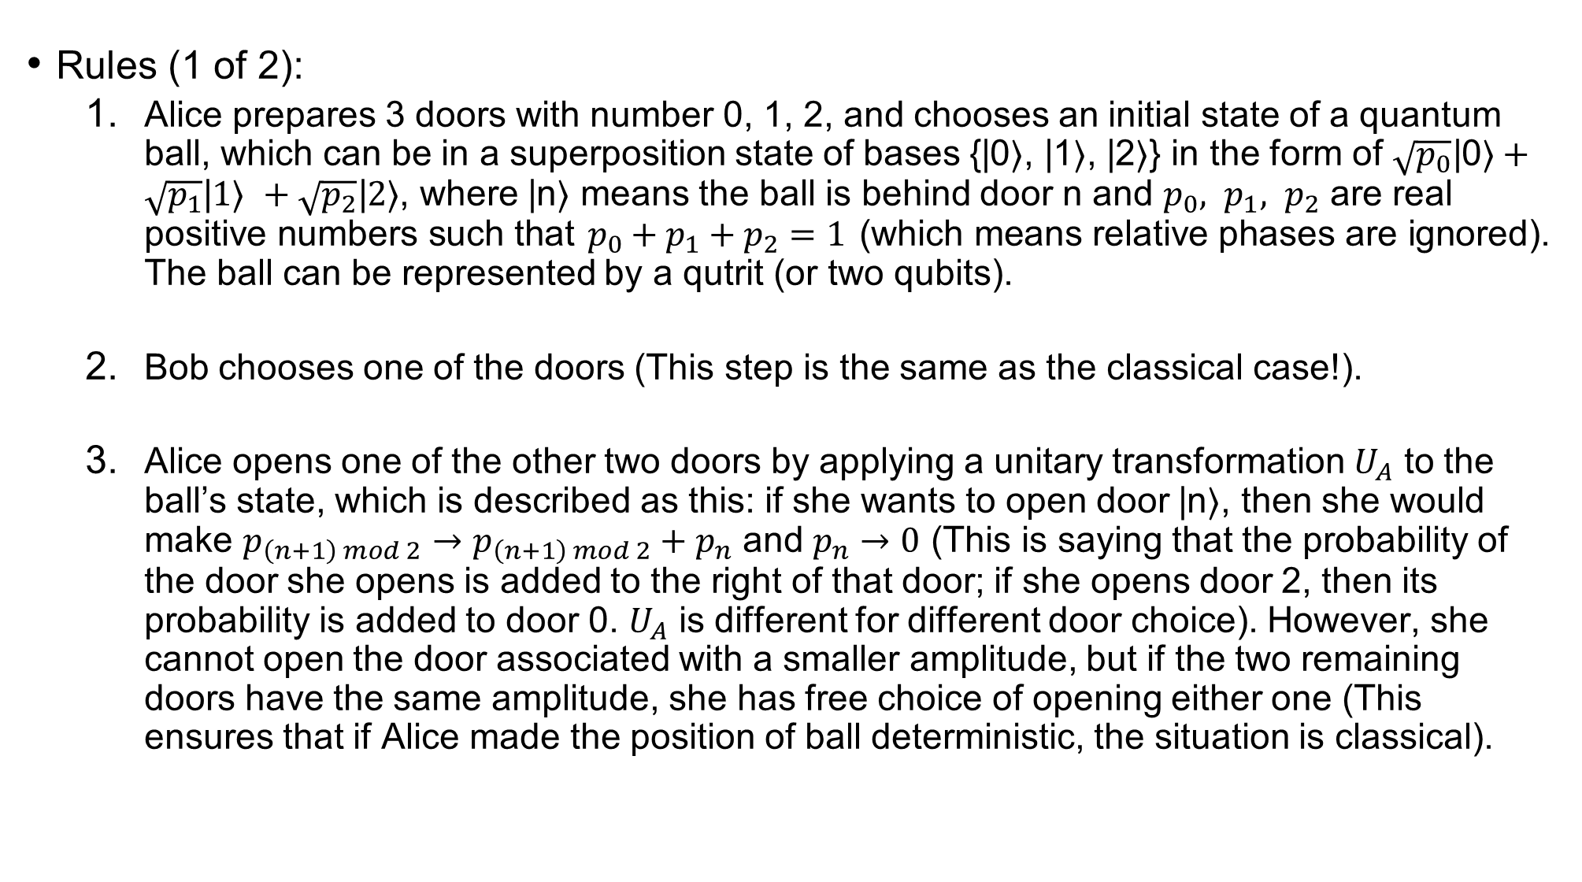
Quantum Monty Hall Problem
Rules (1 of 2):
Alice prepares 3 doors with number 0, 1, 2, and chooses an initial state of a quantum ball, which can be in a superposition state of bases {|0⟩, |1⟩, |2⟩} in the form of $\sqrt{p_{0}}\text{|}\text{0}\text{⟩}+\sqrt{p_{1}}\text{|}1\text{⟩} +\sqrt{p_{2}}\text{|}2\text{⟩}$, where |n⟩ means the ball is behind door n and $p_{0}, p_{1}, p_{2}$ are real positive numbers such that $p_{0}+p_{1}+p_{2}=1$ (which means relative phases are ignored). The ball can be represented by a qutrit (or two qubits).
Bob chooses one of the doors (This step is the same as the classical case!).
Alice opens one of the other two doors by applying a unitary transformation $U_{A}$ to the ball’s state, which is described as this: if she wants to open door |n⟩, then she would make $p_{\left(n+1\right) mod 2}→p_{\left(n+1\right) mod 2}+p_{n}$ and $p_{n}→0$ (This is saying that the probability of the door she opens is added to the right of that door; if she opens door 2, then its probability is added to door 0. $U_{A}$ is different for different door choice). However, she cannot open the door associated with a smaller amplitude, but if the two remaining doors have the same amplitude, she has free choice of opening either one (This ensures that if Alice made the position of ball deterministic, the situation is classical).

Slide 5
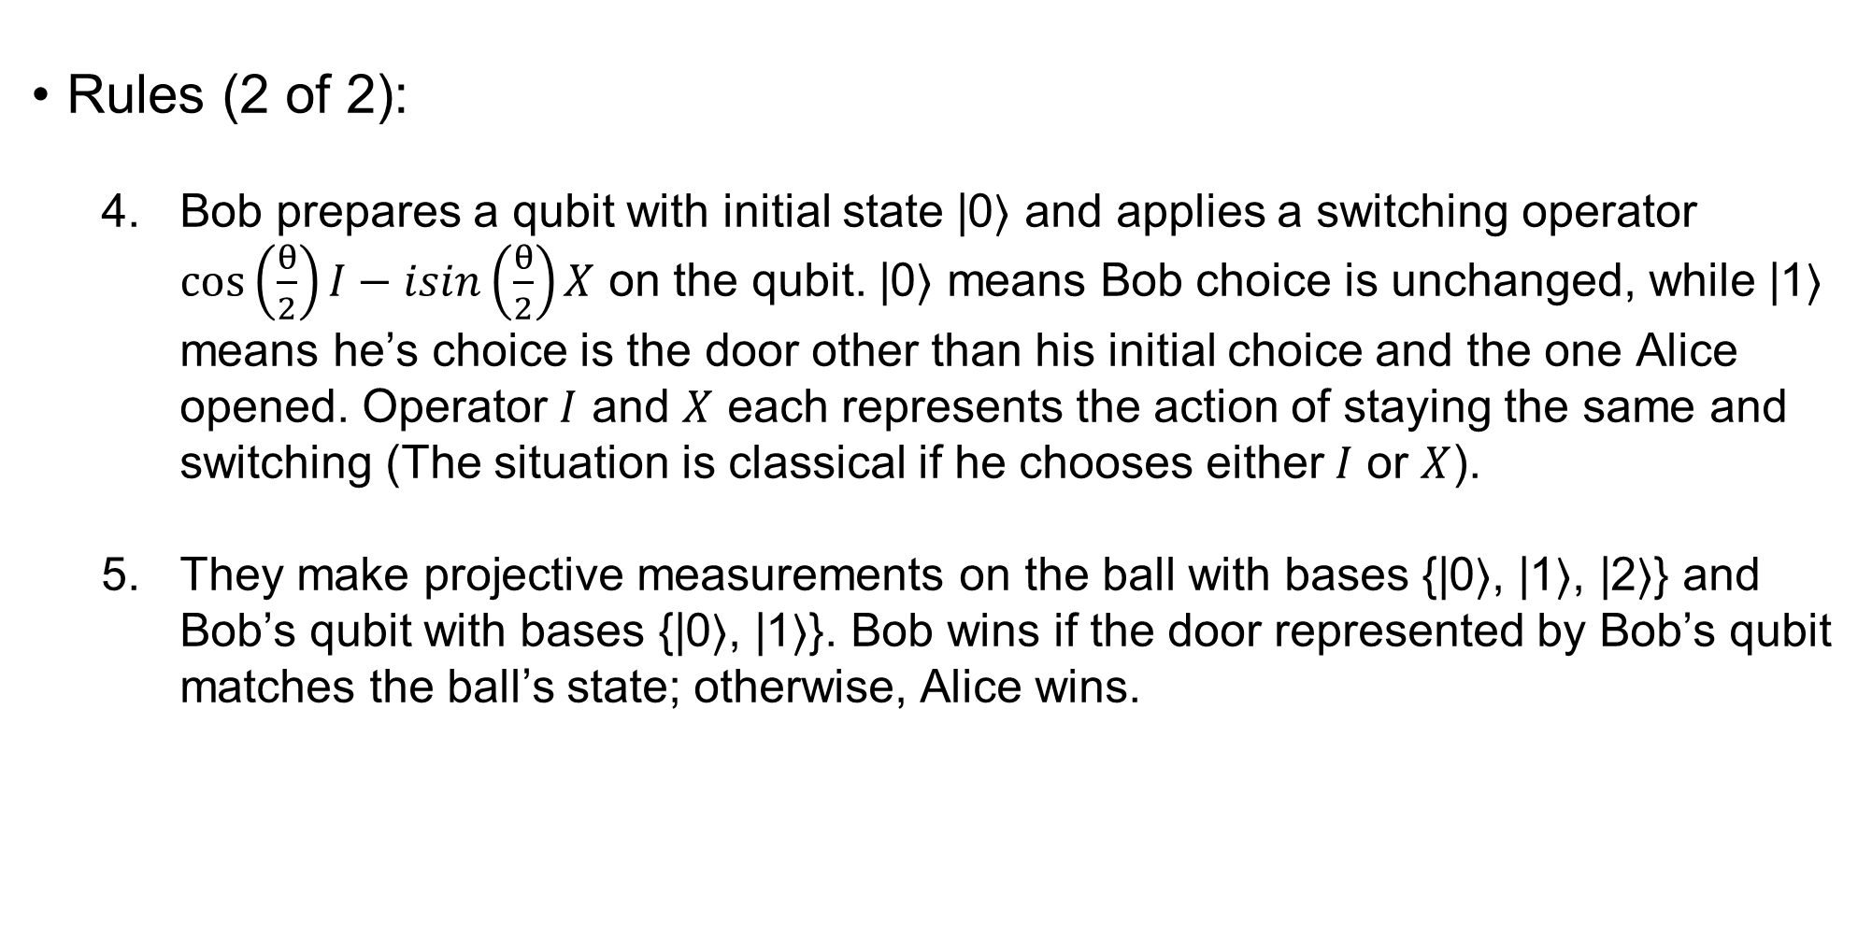
Quantum Monty Hall Problem
Rules (2 of 2):
Bob prepares a qubit with initial state |0⟩ and applies a switching operator $\cos\left(\frac{θ}{2}\right)I−isin\left(\frac{θ}{2}\right)X$ on the qubit. |0⟩ means Bob choice is unchanged, while |1⟩ means he’s choice is the door other than his initial choice and the one Alice opened. Operator $I$ and $X$ each represents the action of staying the same and switching (The situation is classical if he chooses either$I$ or $X$).
They make projective measurements on the ball with bases {|0⟩, |1⟩, |2⟩} and Bob’s qubit with bases {|0⟩, |1⟩}. Bob wins if the door represented by Bob’s qubit matches the ball’s state; otherwise, Alice wins.

Slide 6
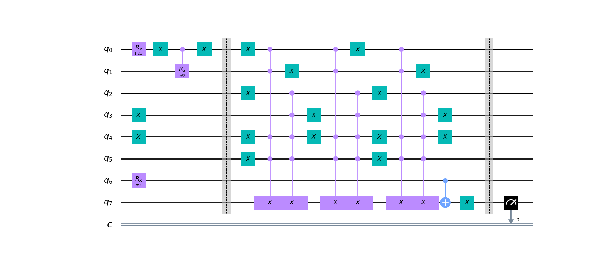
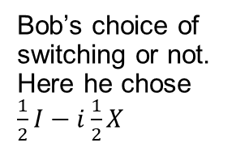
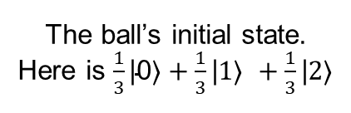
Circuit Construction
Note: This circuit embraces high-level programming techniques, and it can definitely be optimized a lot!
State preparation
State mapping
Measurement
The ball’s initial state. Here is $\frac{1}{3}\text{|}\text{0}\text{⟩}+\frac{1}{3}\text{|}1\text{⟩} +\frac{1}{3}\text{|}2\text{⟩}$
Bob’s initial choice. Here he chooses door 2, which is represented as|10⟩
Alice opens door. Here she opens door 1, which is represented as |01⟩
Bob’s choice of switching or not. Here he chose $\frac{1}{2}I−i\frac{1}{2}X$
Mapping the ball’s state after Alice and Bob making decisions to a single qubit, where |0⟩ represents Bob’s initial choice and |1⟩ represents the remaining door, and use CNOT gate as a classical XOR gate to compare to Bob’s switching decision. Can consider it as three sets of conditional statements
Measurement. Alice wins if got 0, Bob wins if got 1.

Slide 7
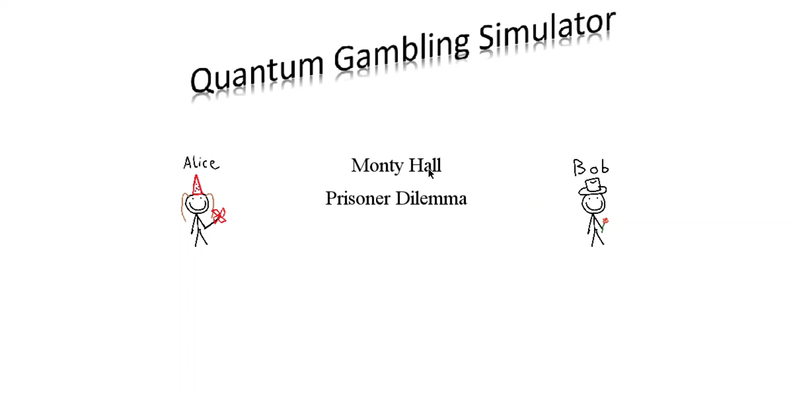
User Interface
This is a short video!

Slide 8


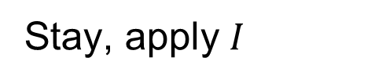



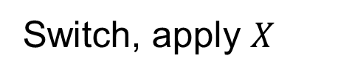
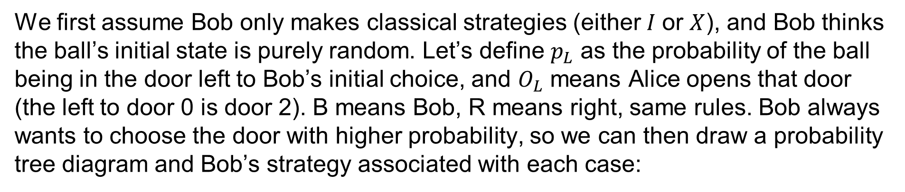
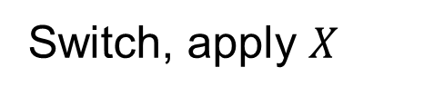



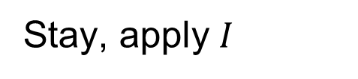

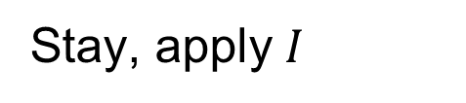


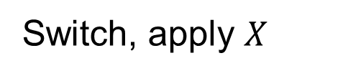
Bob’s strategy
We first assume Bob only makes classical strategies (either$I$ or $X$), and Bob thinks the ball’s initial state is purely random. Let’s define $p_{L}$ as the probability of the ball being in the door left to Bob’s initial choice, and $O_{L}$ means Alice opens that door (the left to door 0 is door 2). B means Bob, R means right, same rules. Bob always wants to choose the door with higher probability, so we can then draw a probability tree diagram and Bob’s strategy associated with each case:
$$p_{L}≥0.5$$
$$O_{R}$$
Switch, apply $X$
1/3
1/2
$$O_{L}$$
Stay, apply $I$
$${\text{∃}p_{i}(p}_{i} ≥0.5)$$
$$p_{B}≥0.5$$
3/4
1/3
1/2
$$O_{R}$$
Stay, apply $I$
Bob’s
classical strategy
1/3
$$p_{R}≥0.5$$
$$O_{L}$$
Switch, apply $X$
1/4
1/2
$$O_{L}$$
Stay, apply $I$
$$\text{∀}p_{i}(p_{i}<0.5)$$
1/2
$$O_{R}$$
Switch, apply $X$

Slide 9


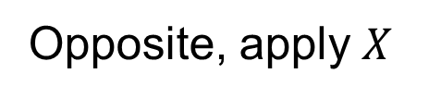
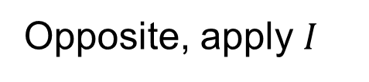


Bob’s strategy
However, there’s one more piece of information than the classical case: the probability of Alice’s opening door goes to its right! Intuitively, this would make that door more likely to have a higher probability. Therefore, we can now divide Bob’s strategies into a new category: “Follow”, which means Bob always follows Alice’s action, by choosing the door in the right of Alice’s opening door; or “Opposite”, by always choosing the other door:
$$p_{L}≥0.5$$
$$O_{R}$$
Follow, apply $X$
1/3
1/2
$$O_{L}$$
Follow, apply $I$
$${\text{∃}p_{i}(p}_{i} ≥0.5)$$
$$p_{B}≥0.5$$
3/4
1/3
1/2
$$O_{R}$$
Opposite, apply $I$
Bob’s
classical strategy
1/3
$$p_{R}≥0.5$$
$$O_{L}$$
Opposite, apply $X$
1/4
1/2
$$O_{L}$$
Follow, apply $I$
$$\text{∀}p_{i}(p_{i}<0.5)$$
1/2
$$O_{R}$$
Follow, apply $X$

Slide 10
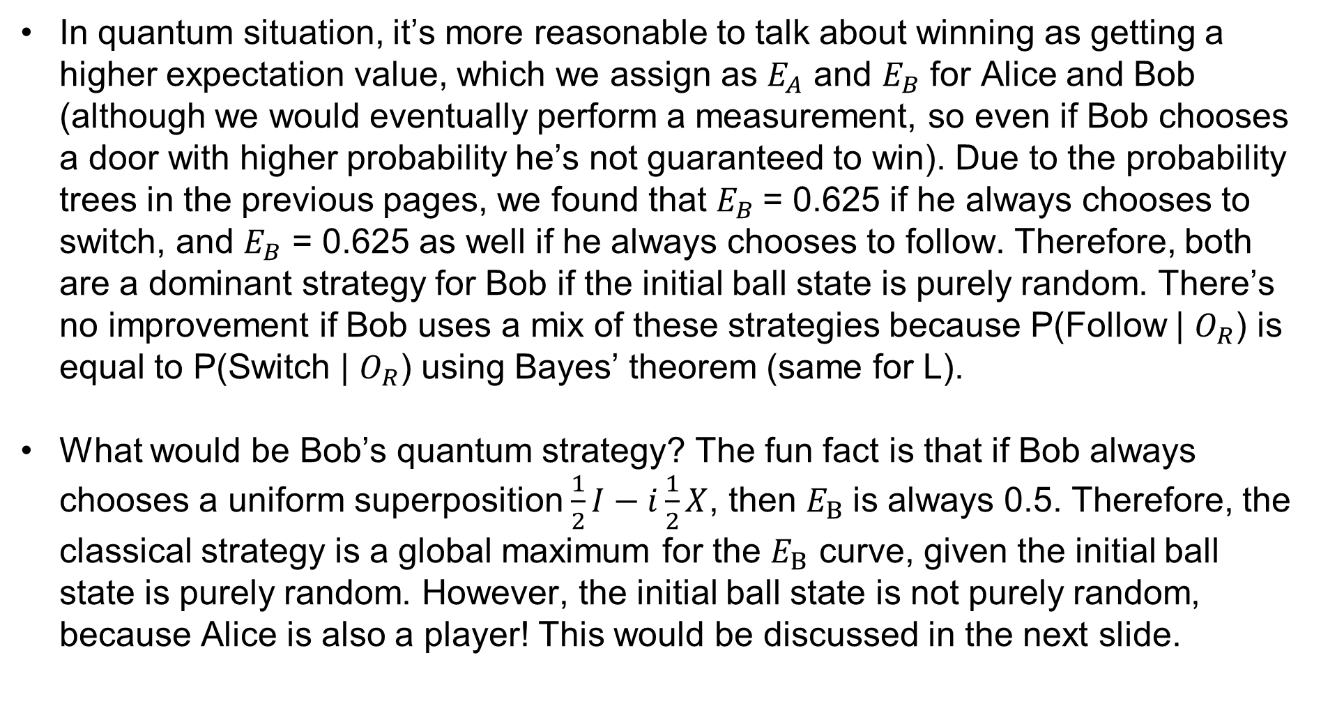
Bob’s strategy
In quantum situation, it’s more reasonable to talk about winning as getting a higher expectation value, which we assign as $E_{A}$ and $E_{B}$ for Alice and Bob (although we would eventually perform a measurement, so even if Bob chooses a door with higher probability he’s not guaranteed to win). Due to the probability trees in the previous pages, we found that $E_{B}$= 0.625 if he always chooses to switch, and $E_{B}$ = 0.625 as well if he always chooses to follow. Therefore, both are a dominant strategy for Bob if the initial ball state is purely random. There’s no improvement if Bob uses a mix of these strategies because P(Follow | $O_{R}$) is equal to P(Switch | $O_{R}$) using Bayes’ theorem (same for L).
What would be Bob’s quantum strategy? The fun fact is that if Bob always chooses a uniform superposition $\frac{1}{2}I−i\frac{1}{2}X$, then $E_{B}$is always 0.5. Therefore, the classical strategy is a global maximum for the $E_{B}$ curve, given the initial ball state is purely random. However, the initial ball state is not purely random, because Alice is also a player! This would be discussed in the next slide.

Slide 11
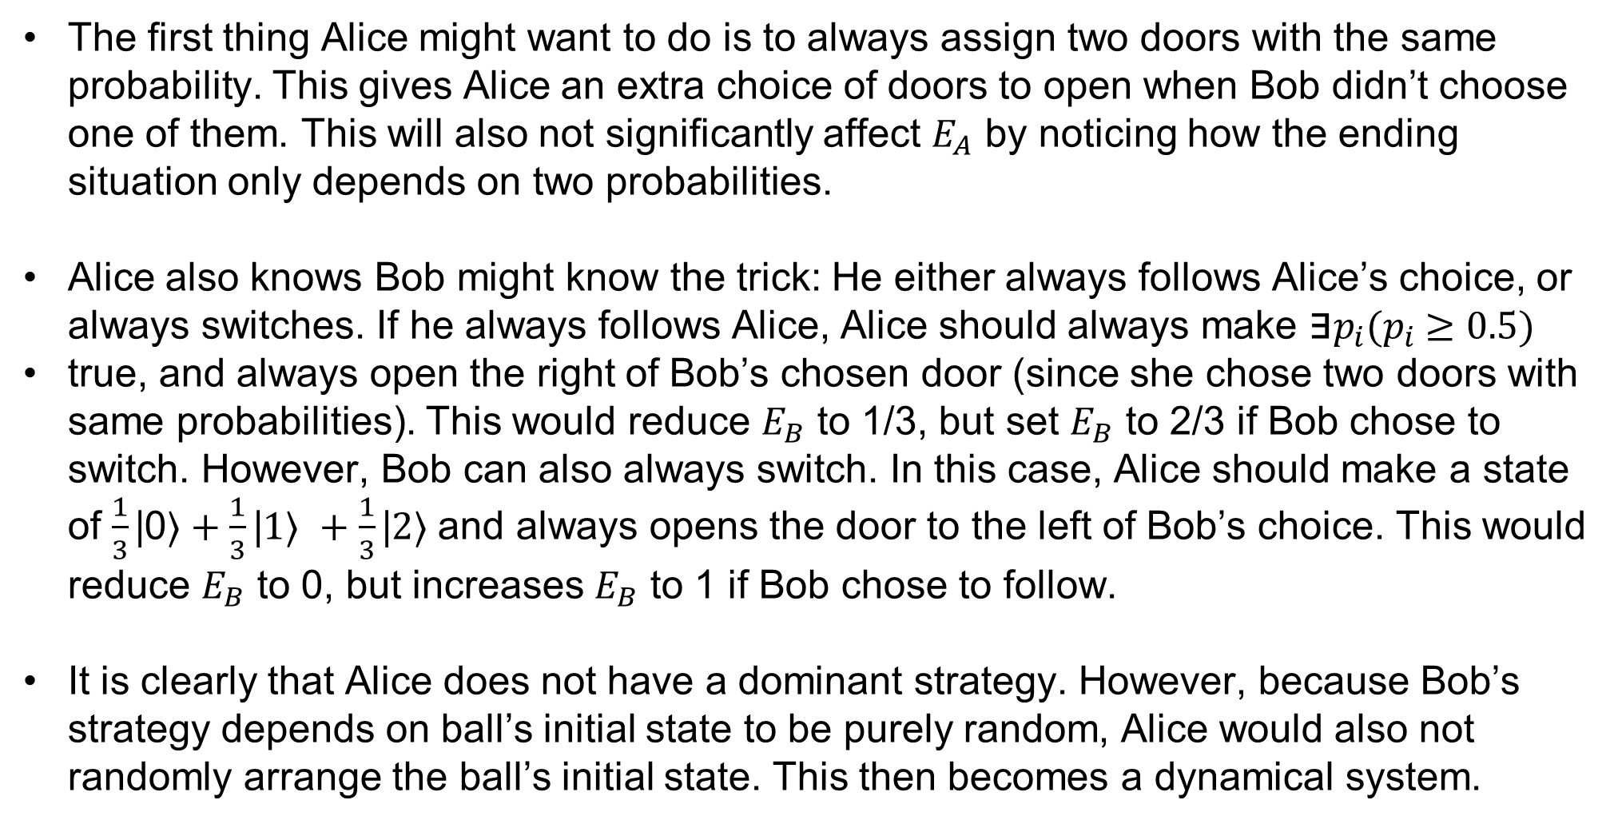
Alice’s strategy
The first thing Alice might want to do is to always assign two doors with the same probability. This gives Alice an extra choice of doors to open when Bob didn’t choose one of them. This will also not significantly affect $E_{A}$ by noticing how the ending situation only depends on two probabilities.
Alice also knows Bob might know the trick: He either always follows Alice’s choice, or always switches. If he always follows Alice, Alice should always make ${\text{∃}p_{i}(p}_{i} ≥0.5)$
true, and always open the right of Bob’s chosen door (since she chose two doors with same probabilities). This would reduce $E_{B}$ to 1/3, but set $E_{B}$ to 2/3 if Bob chose to switch. However, Bob can also always switch. In this case, Alice should make a state of $\frac{1}{3}\text{|}\text{0}\text{⟩}+\frac{1}{3}\text{|}1\text{⟩ }+\frac{1}{3}\text{|}2\text{⟩}$and always opens the door to the left of Bob’s choice. This would reduce $E_{B}$ to 0, but increases $E_{B}$ to 1 if Bob chose to follow.
It is clearly that Alice does not have a dominant strategy. However, because Bob’s strategy depends on ball’s initial state to be purely random, Alice would also not randomly arrange the ball’s initial state. This then becomes a dynamical system.

Slide 12
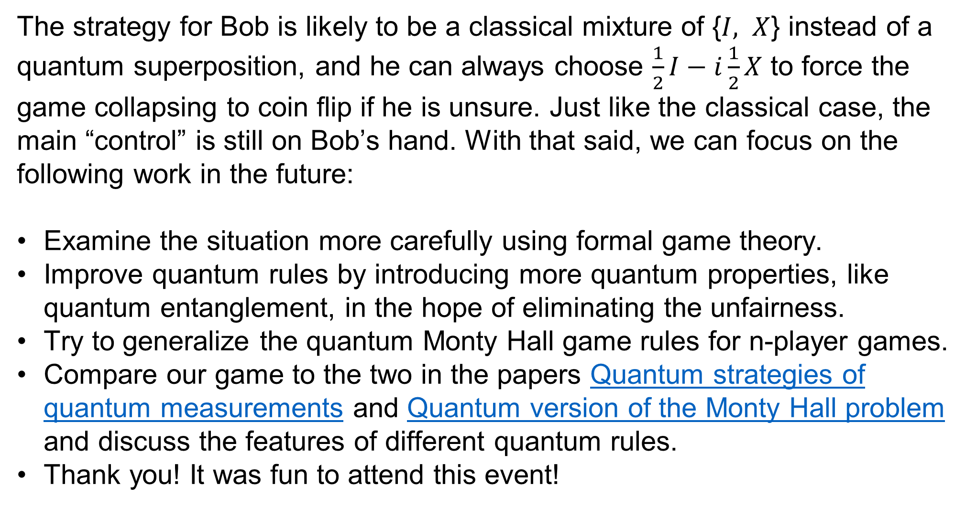
Future Work
The strategy for Bob is likely to be a classical mixture of {$I, X$} instead of a quantum superposition, and he can always choose $\frac{1}{2}I−i\frac{1}{2}X$ to force the game collapsing to coin flip if he is unsure. Just like the classical case, the main “control” is still on Bob’s hand. With that said, we can focus on the following work in the future:
Examine the situation more carefully using formal game theory.
Improve quantum rules by introducing more quantum properties, like quantum entanglement, in the hope of eliminating the unfairness.
Try to generalize the quantum Monty Hall game rules for n-player games.
Compare our game to the two in the papers Quantum strategies of quantum measurements and Quantum version of the Monty Hall problem and discuss the features of different quantum rules.
Thank you! It was fun to attend this event!

